Slide 1
SECURE SOCKET LAYER(SSL)/TRANSPORT LAYER SECURITY (TLS)
DR. O.I. ADELAIYE O.I.

Slide 2
WHY SSL/TLS?
Modification of message/traffic in transit
Impersonation of users
Fake users
Data forgery
Data created by an intruder are considered to be genuine
Eavesdropping on the net
Loss of privacy

Slide 3
WHY? WEB SECURITY REQUIREMENT
Data Integrity
Ensures that the received data is the same as when sent by the sender
Using checksums, message authentication codes
Confidentiality
Protection of data from unauthorized disclosure
Using encryption
Authentication
The proof of the communicating entity is the one it pretends to be
Essential on the server side, optional on the client one
Using challenge-response, username/password, certificates, …
Objectives of SSL/TLS
Allow two entities to authenticate
Establish session keys

Slide 4
WEB SECURITY APPROACHES
Question: where should we put the security mechanisms?
Under TCP: IPSec, between IP and TCP
Requires changes to OS, applications over TCP do not change
Over TCP: SSL/TLS
Does not require changes to OS, applications over TCP need to change
TCP is a reliable service: SSL does not need timing out controls or data retransmission techniques

Slide 5
HISTORY
Secure Network Programming (SNP) API
Encapsulating sensitive information in a secure layer (1993)
The SNP project received the 2004 ACM software system award
Secure Socket Layer (SSL)
Originally proposed by Netscape
SSL v1 contained loads of security flaws, never made public
SSL v2 was released in 1994 and implemented in Netscape Navigator 1.1 in 1995,
Had a number of security flaws which were pointed out by the experts
Microsoft version: Private Communication Technology (PCT)
SSL v3 was released in 1996
SSL v3 uses RSA which had a patent on it, it could not be standardised in its original form, so …
Transport Layer Security (TLS)
Internet standard variation of SSL
TLS 1.0 was published in 1999 by the IETF

Slide 6
BASIC PROTOCOL
A client wants to securely connect to a server
At least authentication of the server as well as data integrity and confidentiality are required
The server has a X.509 certificate from a trusted Certification Authority (CA)
The root CA is built (or manually added) into the web browser of the client
The server returns its certificate when contacted by the client’s web browser
The web browser encrypts a random number using the public key of the certificate
The encrypted random number is sent to the server as a challenge
Once the server responds correctly, a secure channel is established between the server and the web browser

Slide 7
SSL HANDSHAKE PROTOCOL
Comprises 4 phases
Phase 1 Establishes the capabilities of the client and server
Phase 2 Server authentication and key exchange
Phase 3 Client key exchange and optional client authentication
Phase 4 Change Cipher Specification Protocol and Finish

Slide 8
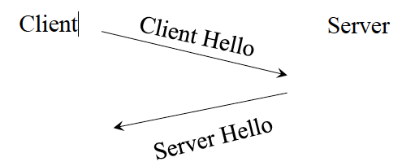
SSL HANDSHAKE PHASE 1
The client hello message contains
The versions of SSL supported by the client
The algorithms supported by the client
Nonces to protect against replay (a time stamp and random number)
Session ID (initially set to zero)
The server hello message contains
The SSL version chosen by the server (highest one)
The set of algorithms chosen by the server
Server nonces to stop replay (a time stamp and random number)
Session ID (chosen by the server)

Slide 9
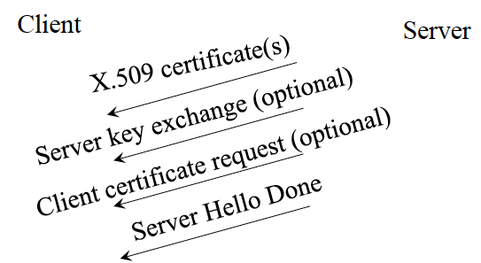
SSL HANDSHAKE PHASE 2
The server sends to the client
Its X.509 public key certificate chain up to the root CA
If the server supports client authentication, a client certificate request
If Diffie Helman key exchange is being used, the key parameters
The Server Hello Done message

Slide 10
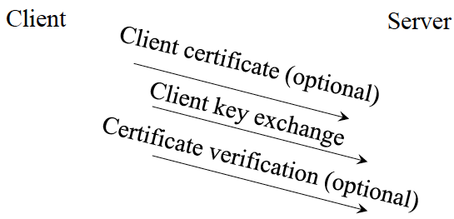
SSL HANDSHAKE PHASE 3
The client sends to the server
Key exchange parameters encrypted with server’s public key
Diffie-Helman: the client sends its half of the secret parameter
RSA: the client sends a 48 bytes pre-master secret
Optionally its public key certificate and a verification message (signature on the hash of the exchanged messages)

Slide 11
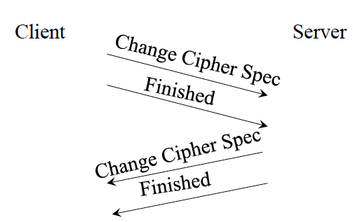
SSL HANDSHAKE PHASE 4
Phase 4 The client tells the server to change ciphers to the agreed set and then it is finished
The server sends a keyed hash of all the handshake messages
The server agrees to both

Slide 12
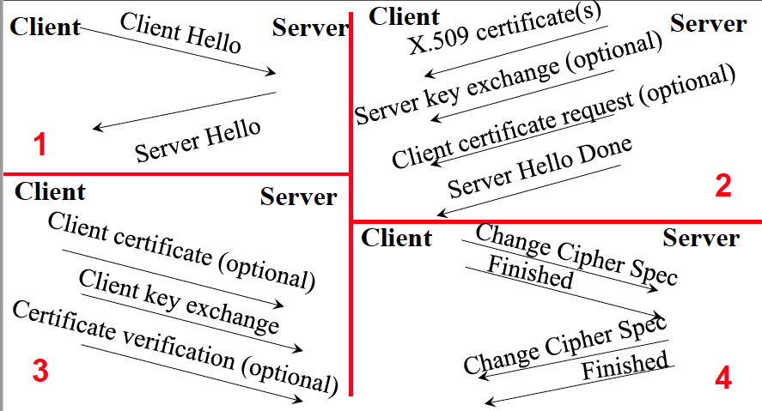
SSL HANDSHAKE SUMMARY

Slide 13
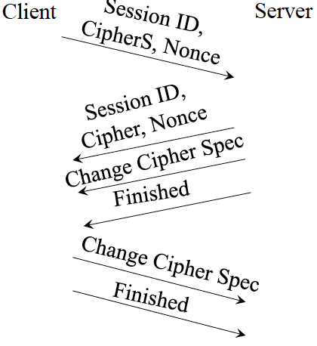
RESUMING SESSIONS
In Phase 1 the Session ID is set to the Session ID previously returned by the server at start of session
If the server accepts, it proceeds straight to the Finished phase
Nonces are exchanged, so the session keys are unique

Slide 14
CALCULATION OF SHARED SECRET
The pre-master secret from Phase 3 is concatenated with the client and server random numbers to provide a master secret, which is then hashed to produce
A shared secret for message authentication codes (MAC) created by the client for data integrity
A shared secret for MACs created by the server
A symmetric encryption key for messages sent by the client
A symmetric encryption key for messages sent by the server
The reason the client and server use different keys is to make it more difficult to break the messages
In SSLv2 there were 2 keys, one on each side for both encryption and MACs

Slide 15
CLIENT AUTHENTICATION
Theoretically, SSL/TLS allows client authentication by sending the client certificate
In practice, the client sends their username/password to the server over the established session

Slide 16
SUMMARY: SSL SECURITY SERVICE
Data Integrity
A keyed hash (MAC) is appended to the message
Confidentiality
Symmetric encryption of the message and MAC
Authentication
The server is always authenticated
The client optionally sends its certificate to the server

Slide 17
CRYPTO ALGO. SUPPORTED BY SSL
Encryption
Stream Encryption: RC-4 (40 and 128 bits)
Block Encryption: DES (40 and 56 bits), Triple DES (168 bits), or IDEA (128 bits)
Message Authentication Codes
MD5 or SHA1
Key Generation
Diffie-Helman and RSA (Ron Rivest, Adi Shamir, and Leonard Adleman)

Slide 18
SSL MESSAGES
SSL/TLS partitions the reliable octet stream of TCP into records, a record can be either
Handshake: session establishment and initialisation
Change cipher: switches to a given set of security algorithms
Could simply have been a handshake message
User data: the application protocol (SMTP, FTP, LDAP, HTTP, …). HTTP is the most common, runs at port 443 (HTTPS)
Alerts: error messages and notification of connection closure

Slide 19
SSL ALERT PROTOCOL MESSAGE
Used to convey alerts and errors to the client
The alert messages are protected according to the ciphers agreed for the SSL session
Each message consists of two bytes
The first byte indicates the severity of the alert
1- warning, 2- fatal
If the level is fatal SSL terminates the connection
The second byte contains the code that indicates the specific type of alert

Slide 20
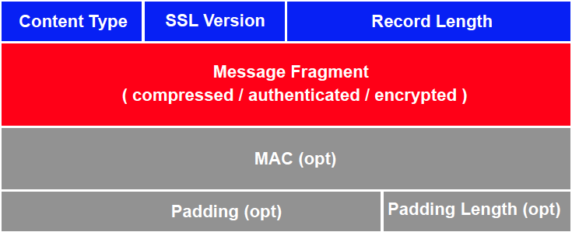
SSL RECORD PROTOCOL
The application message is broken up into fragments
The SSL Record Protocol is applied to each fragment
Provides confidentiality via encryption
Provides message integrity with a MAC
Optional compression

Slide 21
TCP AND SSL SESSIONS
Connections between client and server are provided by TCP
A SSL session is an association between the client and the server
SSL sessions run over TCP connections
SSL was designed to work with HTTP1.0
Opens a lot of TCP connections (one for each item)
An SSL session should be able to span multiple TCP connections, both sequentially and in parallel
A client and server can disconnect then reconnect and continue using the same SSL session
SSL sessions are created using the SSL Handshake Protocol
The generated master key could be reused to resume the session in a “cheap” way.

Slide 22
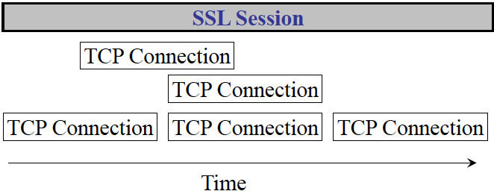
TCP CONNECTIONS AND SSL

Slide 23
SHORT COMINGS: SSL
User authentication is not available in v2
Optional in v3
Web based CAs do not always authenticate the customer strongly
e.g. Verisign Class 1,
The server can not trust the user’s certificate
Poor support for certificate revocation in SSL products
Most web clients would not know if a server’s certificate had been revoked
If the system is configured poorly, it is possible for SSL to negotiate a NULL cipher suite so that no protection is carried out at all

Slide 24

TLS VS. SSL
TLS and SSL are similar but incompatible
TLS algorithms
DSA (Digital Signature Algorithm), RSA is optional
Message authentication code: keyed-Hash Message Authentication Code (HMAC)
SSL uses its own keyed hash algorithm
Secret key generation: MD5 and SHA-1
Signature: MD5 and SHA-1

Slide 25
SUMMARY
TLS is the Internet standard version of SSL
SSL/TLS provides application-level security over TCP
SSL/TLS provide
Confidentiality, using symmetric encryption
Data Integrity, using message authentication codes
Optional client authentication, using public key certificates
SSL/TLS allow the negotiation of security mechanisms between two users

Slide 26
END

